Slide 1
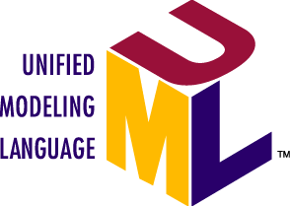
What is UML?
An international industry standard graphical notation for describing software analysis and design.
pictures or views of an OO system
helps better understanding
a picture is worth a thousand words

Slide 2
UML diagrams
UML = Unified Modeling Language
Use case diagrams
Class diagrams
Sequence diagrams
Collaboration diagrams
Statechart diagrams
Object diagrams
Activity diagrams
Component diagrams
Deployment diagrams
…

Slide 3
Use Cases
What is a Use Case?
A formal way of representing how a business system interacts with its environment
Illustrates the activities that are performed by the users of the system
A scenario-based technique in the UML
A sequence of actions a system performs that yields a valuable result for a particular actor.

Slide 4
Actors
An Actor is outside or external the system.
It can be a:
Human
Peripheral device (hardware)
External system or subsystem
Time or time-based event
Represented by stick figure with name below
Patient
Notes:
Actors
Are NOT a part of the system (external to the system)
A single actor may represent multiple physical users
Whether human or not, represented by stick figure
MUST label stick figure with the name of the actor

Slide 5
Actors and stakeholders
What is an actor? A primary actor?
What is the difference between an actor and a stakeholder?
actor: anything with behavior that acts on the system
primary actor: initiates interaction to achieve goal (when system is a software product, primary actor is often the computer user)
supporting actor: performs sub-goals to help use case
stakeholder: anyone interested in the system
examples: supplier, stock agency, vendor
the difference: stakeholder might not "act" in any scenario

Slide 6
How to identify actors?
Who is interested in the scenario/system?
Where in the organization is the scenario/system be used?
Who will benefit from the use of the scenario/system?
Who will supply the scenario/system with this information, use this information, and remove this information?
Does one person play several different roles?
Do several people play the same role?
Notes:
Actors
7) Does one person play several different roles?
May have an actor for each role
8) Do several people play the same role?
Only use one actor per role (no matter how many people play that role)
Identifying actors is an iterative process
Defining how an actor interacts with the system may clarify whether there are duplicate actors or not

Slide 7
Use Case Diagrams
Use case diagrams describe what a system does from the standpoint of an external observer. The emphasis is on what a system does rather than how.
Use case diagrams are closely connected to scenarios. A scenario is an example of what happens when someone interacts with the system.

Slide 8
Use Cases
Each use case in a use case diagram describes one and only one function in which users interact with the system
May contain several “paths” that a user can take while interacting with the system
Each path is referred to as a scenario
Represents an activity of an actor
Use cases as ellipses with their names below or inside
Make appointment
Actors are stick figures. Use cases are ovals. Communications are lines that link actors to use cases.

Slide 9
Use Case - Relationships
Boundary
A boundary rectangle is placed around the perimeter of the system to show how the actors communicate with the system.
Make
Appointment
Patient
Notes:
System boundary: A system boundary defines the scope of what a system will be. A system cannot have infinite functionality. So, it follows that use cases also need to have definitive limits defined. A system boundary of a use case diagram defines the limits of the system. The system boundary is shown as a rectangle spanning all the use cases in the system.
Other use cases in this lecture also show the system boundary of the clinic application. The use cases of this system are enclosed in a rectangle. Note that the actors in the system are outside the system boundary.
The system boundary is potentially the entire system as defined in the problem statement. But this is not always the case. For large and complex systems, each of the modules may be the system boundary. For example, for an ERP system for an organization, each of the modules such as personnel, payroll, accounting, and so forth, can form the system boundary for use cases specific to each of these business functions. The entire system can span all of these modules depicting the overall system boundary.

Slide 10
Use Case - Relationships
Relationships
Represent communication between actor and use case
Depicted by line or double-headed arrow line
Also called association relationship
Make
Appointment
Make appointment
Patient

Slide 11
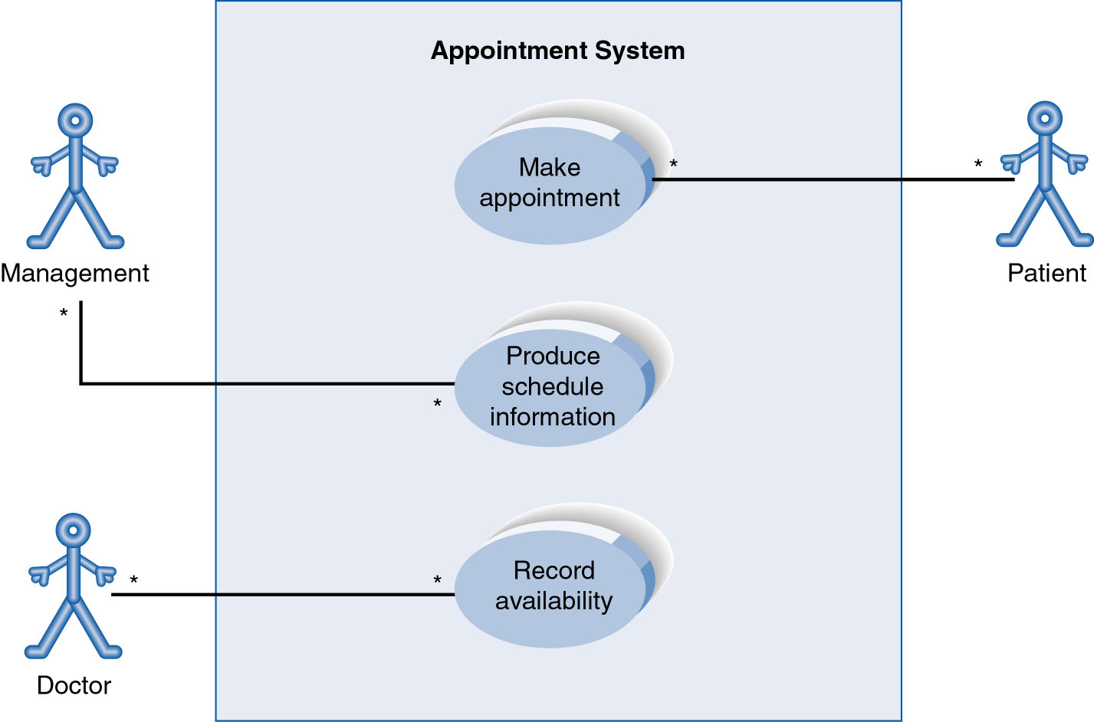
Sample use case diagram: Hospital

Slide 12
Use Case relationship: Generalization
Generalization
From child to parent
Represented by a line and a hollow arrow
Patient
New Patient
Old Patient
Notes:
Inheritance

Slide 13
Use case relationships: Extend
Extend
Represents the extension of the use case to include optional functionality
Arrow is drawn from the extension use case to the base use case
Write << extend >> above arrowhead line
<<extend>>
Update patient information
Make appointment

Slide 14
Use case relationship: Include
Include
Represents the inclusion of the functionality of one use case within another
Arrow is drawn from the base use case to the used use case
Write << include >> above arrowhead line
<<include>>
Record availability
Manage schedule

Slide 15
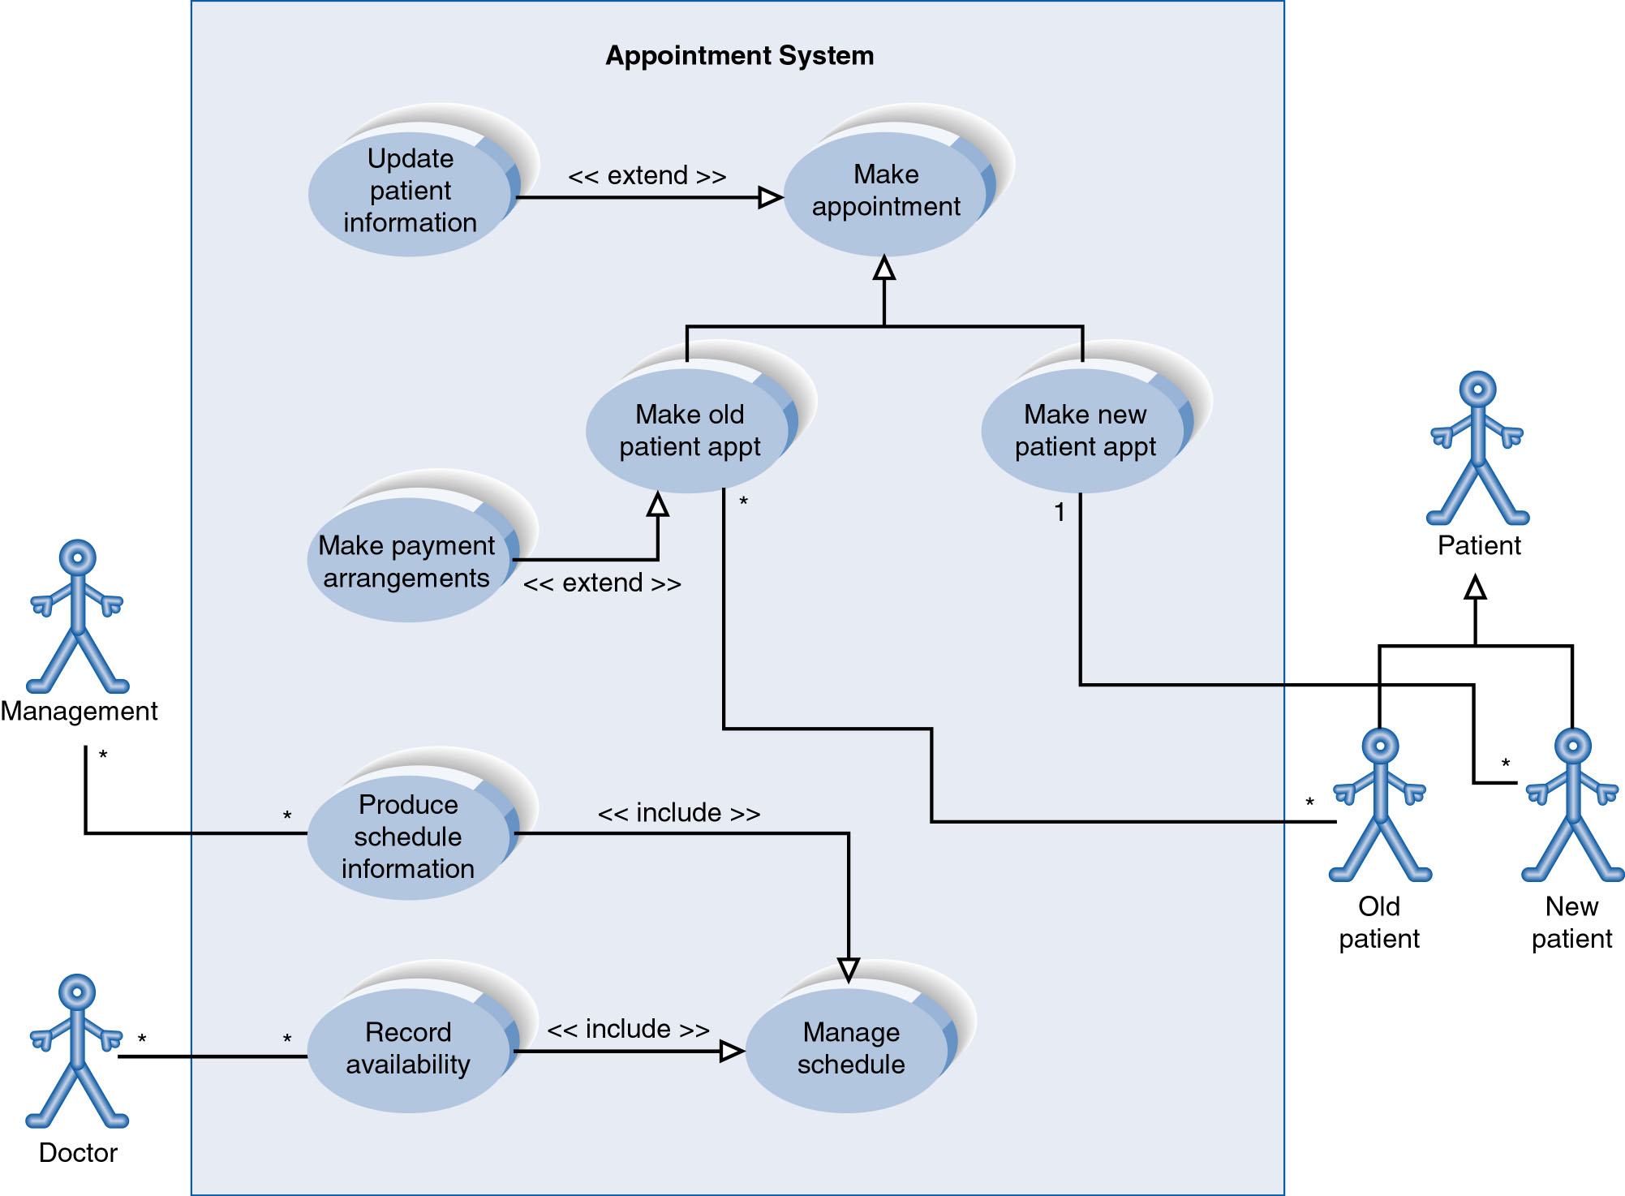
Use case with relationships

Slide 16
UML editors
Rational Rose (commercial): http://www-03.ibm.com/software/products/en/ratirosefami
ArgoUML: http://argouml.tigris.org/
Violet: http://alexdp.free.fr/violetumleditor/page.php
Visual Pardigm (commercial): http://www.visual-paradigm.com/solution/freeumltool/
StarUML: http://staruml.io/
UMLet: http://www.umlet.com/

